Slide 1

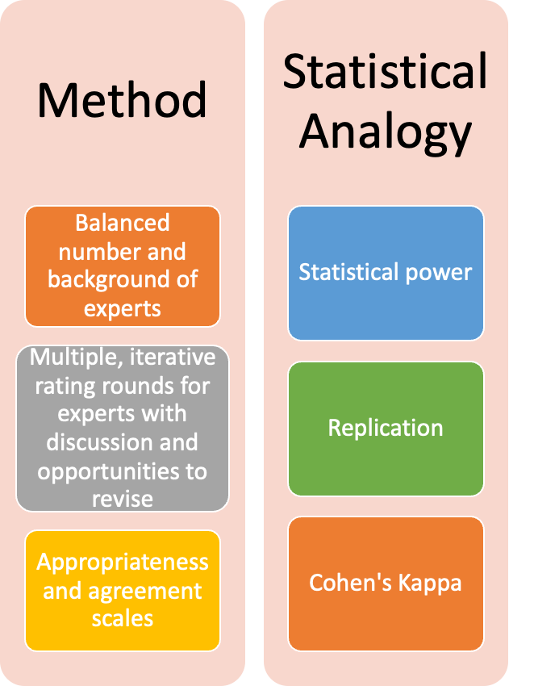

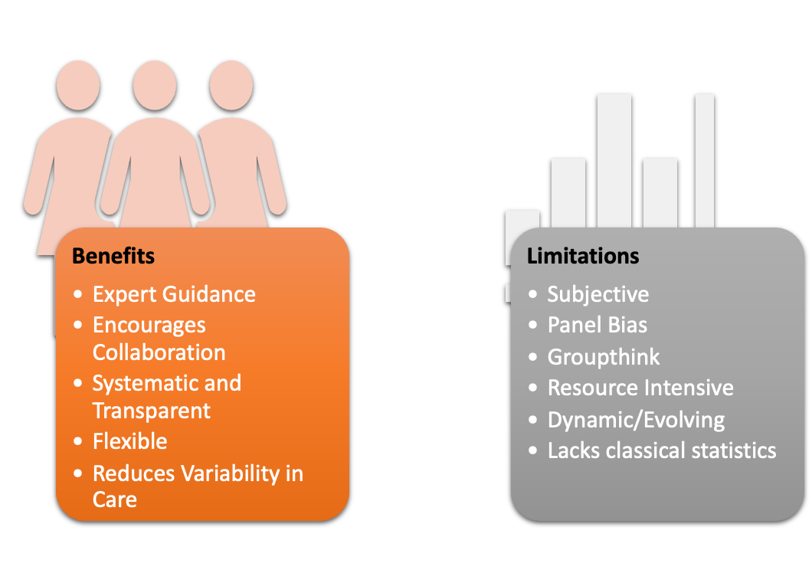
Statistical Considerations in the Development of a Consensus Statement Joshua J. Cook, M.S.¹, Andrew Jimenez, B.S.², Joshua Stillman, B.S.³, Achraf Cohen, Ph.D. ¹ ¹University of West Florida (UWF), ²Georgetown University School of Medicine (GU), ³University of Florida (UF)
Company or University Logo
INTRODUCTION
Nominal Group Technique
EVALUATING RAND/UCLA METHODOLOGY (RAM)
STATISTICAL CONSIDERATIONS
CONCLUSION AND ADDITIONAL RESOURCES
•Method
Defining a consensus statement:
“A comprehensive summary of the opinions of a panel of experts… to provide guidance to health care professionals, especially on controversial or poorly understood aspects of care”
-Miller-Keane Encyclopedia
When are they used?
Rare / high-risk medical conditions
Open standards for technological development
Economic policy guidance
Conclusion:
Consensus studies (i.e., statements) are key tools to assess clinical treatment appropriateness and agreement among experts.
However, they are based on opinions, and thus do not have the same statistical rigor of traditional studies.
Care should be taken to include measures outside of traditional statistics to ensure the validity and reliability of findings.
GitHub Repository:
Full Links & Terms
Literature Review
Simulation of RAM in R
Author Contact
Statistical Analysis:
Descriptive statistics: median and IQR rating for each scenario (resistant to extreme opinions)
Hypothesis testing / power analysis: not applicable; opinion-based, try to balance backgrounds of experts
Consensus threshold: based on scenario medians (appropriate, uncertain, inappropriate) and IQR (level of disagreement)
RAND/UCLA Appropriateness Method (RAM):
Define expert criteria (industry-dependent)
Select panel of experts (n = 9-15; not based on statistical power / hypothesis tests)
Literature review for initial clinical comparison round (usually PRISMA guidelines)
1st round - experts independently rate appropriateness of clinical scenarios based on clinical judgment/appropriateness (1-9)
2nd round - experts meet to discuss ratings, then given the opportunity to rate again; third round if needed
Expert consensus reached to provide recommendations for clinical indications
Delphi
Mixed
And
Modified Approaches
RAM
Methods to increase validity and reliability:
Consensus Methods
Nominal Group Technique
Consensus Conference
REFERENCES
Birko S, Dove ES, Özdemir V. Evaluation of Nine Consensus Indices in Delphi Foresight
Research and Their Dependency on Delphi Survey Characteristics: A Simulation Study and Debate on Delphi Design and Interpretation. PLoS One. 2015;10(8):e0135162. Published 2015 Aug 13. doi:10.1371/journal.pone.0135162
Fitch, K., Bernstein, S. J., Aguilar, M. D., Burnand, B., LaCalle, J. R., Lázaro, P., ... & Kahan, J. P. (2001). The RAND/UCLA appropriateness method user's manual. RAND Corporation.
Kwong, J. S., Chen, H., & Sun, X. (2016). Development of Evidence-based Recommendations: Implications for Preparing Expert Consensus Statements. Chinese medical journal, 129(24), 2998–3000. https://doi.org/10.4103/0366-6999.195475
Miller BF, Keane CB, O’Toole MT. Encyclopedia & Dictionary of Medicine, Nursing, & Allied Health. 7th Edition. Saunders; 2003.
Siwiec, J., Konieczna, M., & Koperny, M. (2019). Good practice for guidance development – review of consensus methods. Zeszyty Naukowe Ochrony Zdrowia. Zdrowie Publiczne i Zarzadzanie, 17(4), 217-229. doi:https://doi.org/10.4467/2G842627OZ.19.023.12185
Sparks JB, Klamerus ML, Caverly TJ, et al. Planning and Reporting Effective Web-Based RAND/UCLA Appropriateness Method Panels: Literature Review and Preliminary Recommendations. J Med Internet Res. 2022;24(8):e33898. Published 2022 Aug 26. doi:10.2196/33898

